Slide 1
Models S and R Comparison

Slide 2
Equations
Model S
Model R

Slide 3
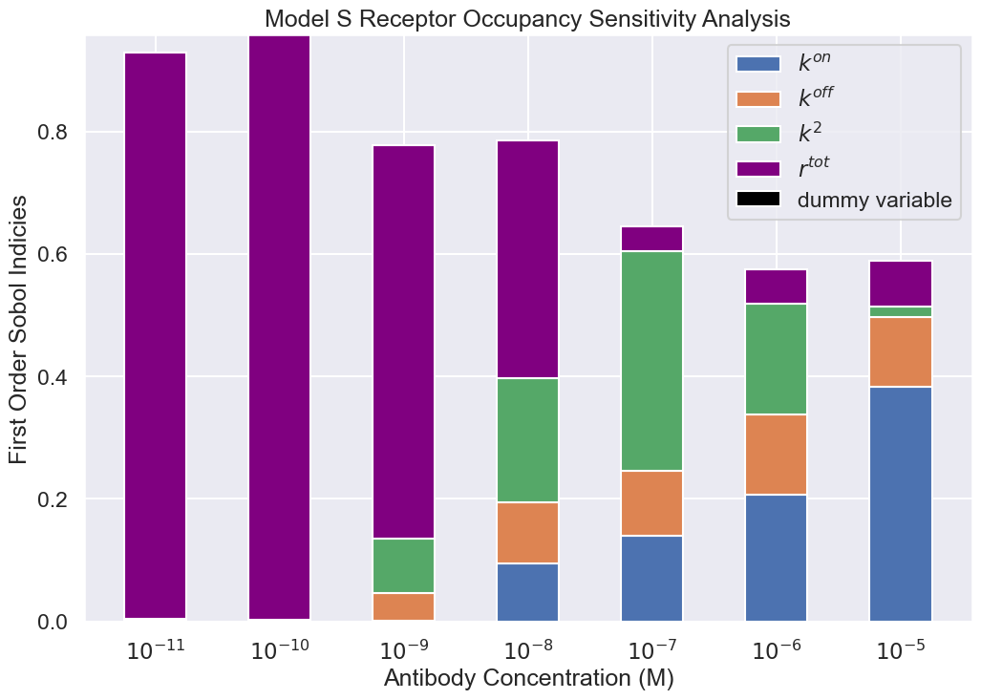
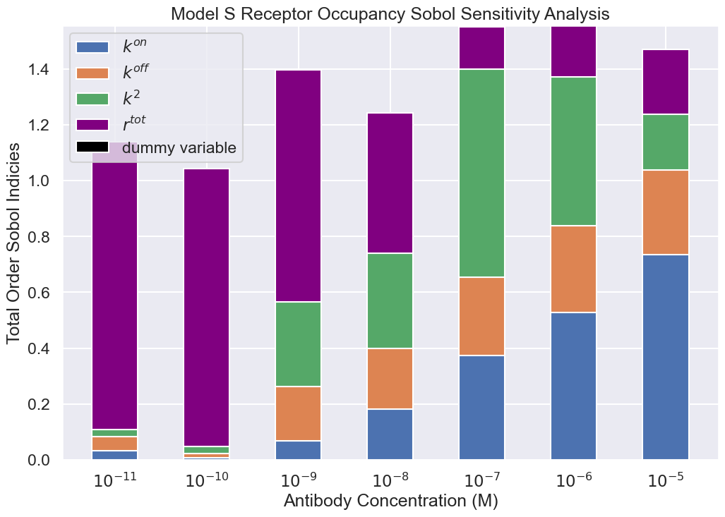
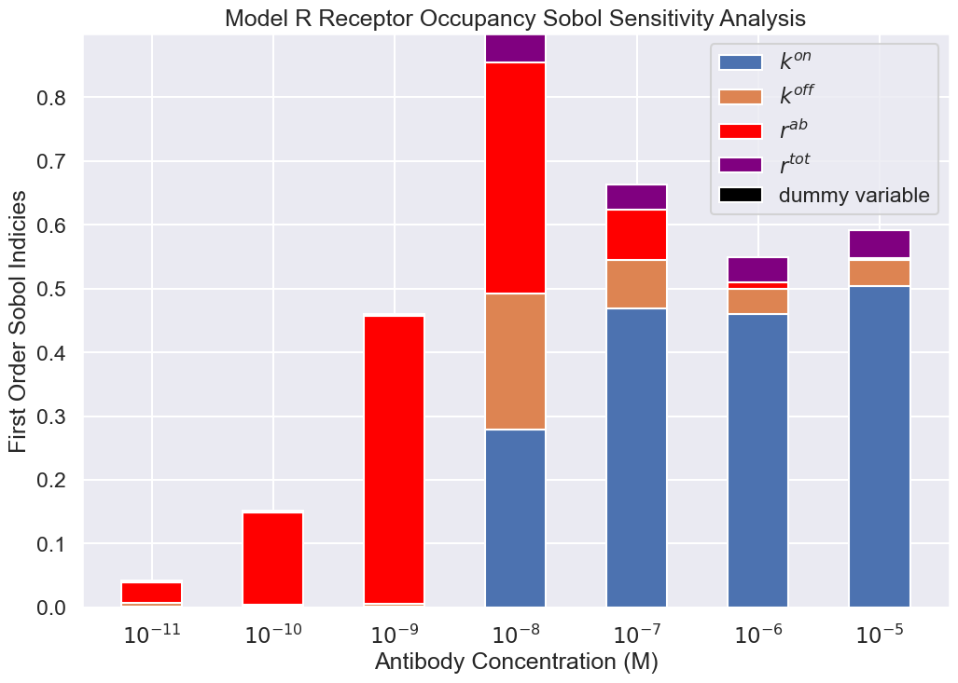
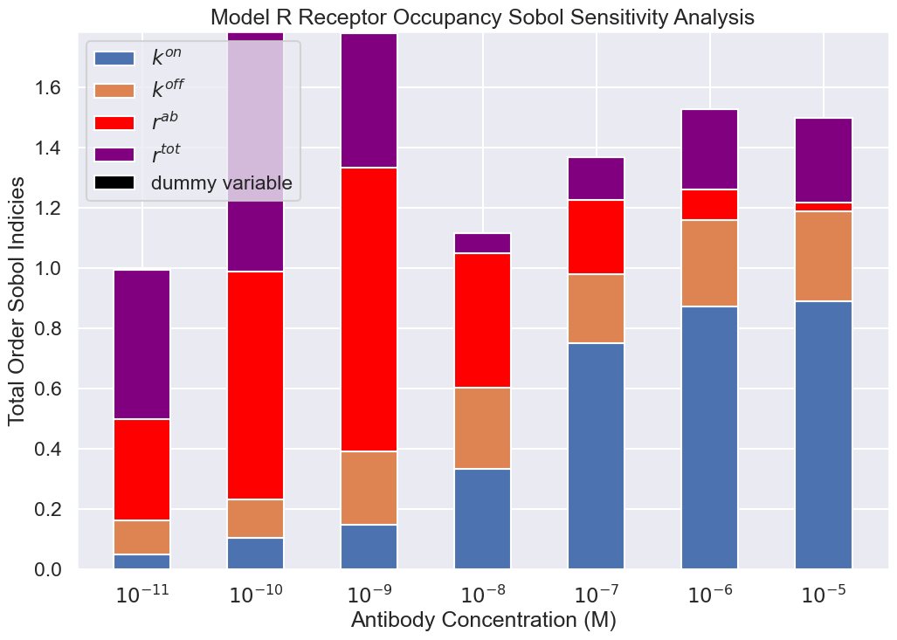
Total Order Sobol Analysis for Receptor Occupancy

Slide 4
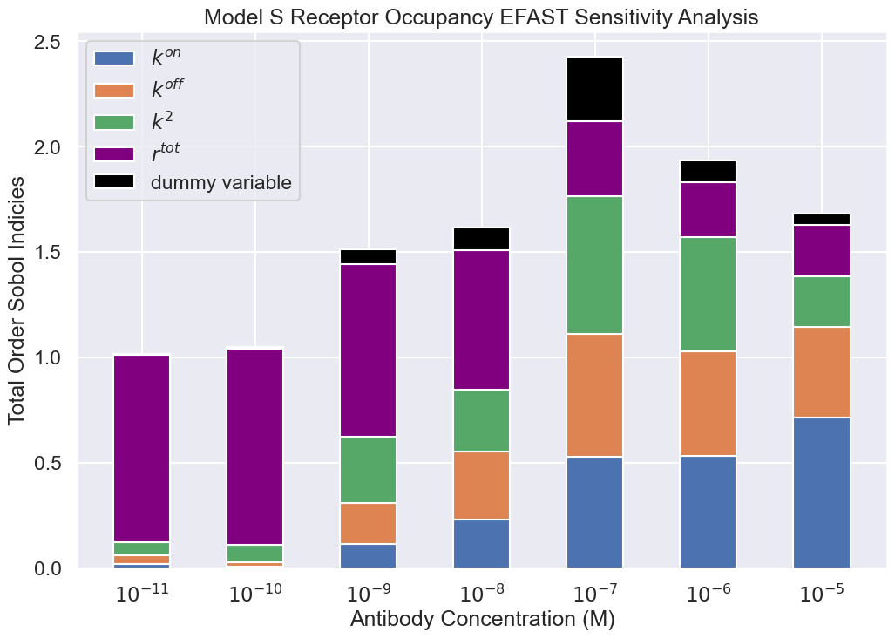
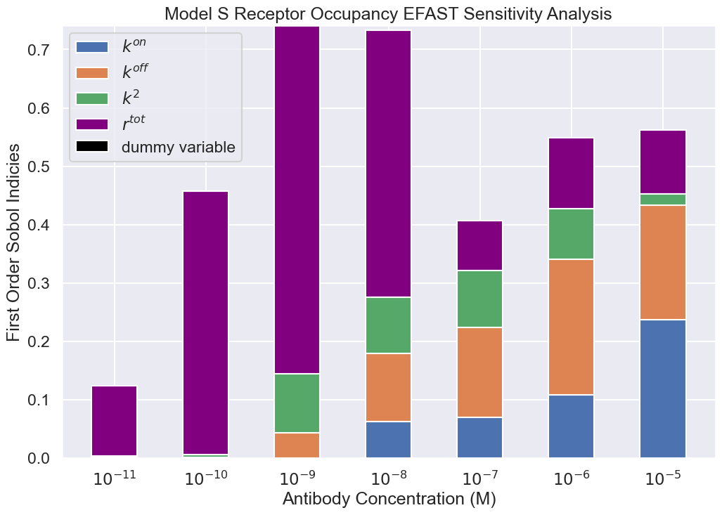
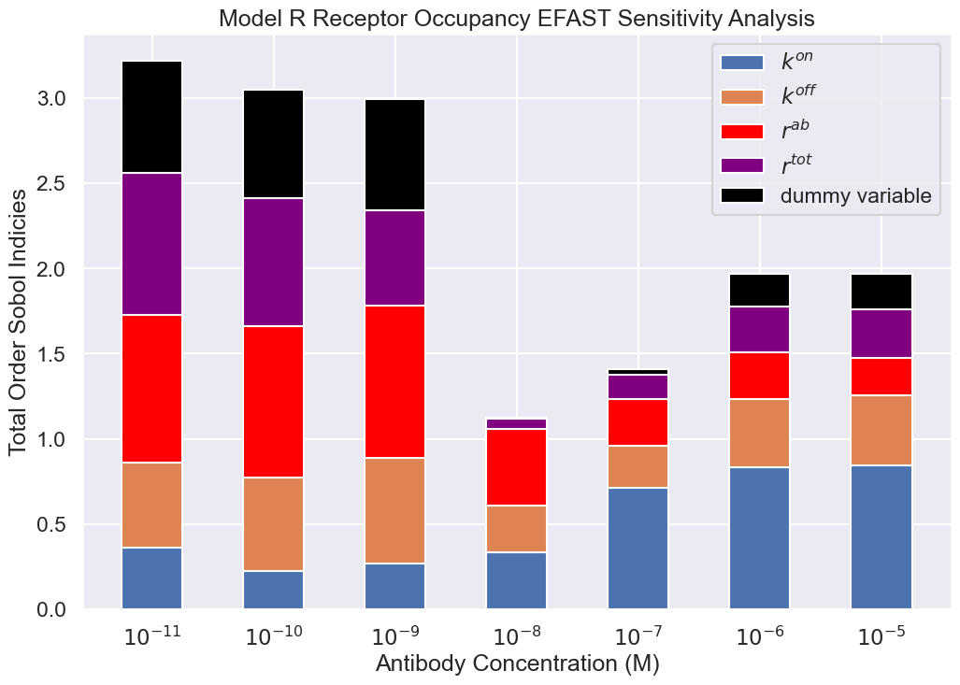
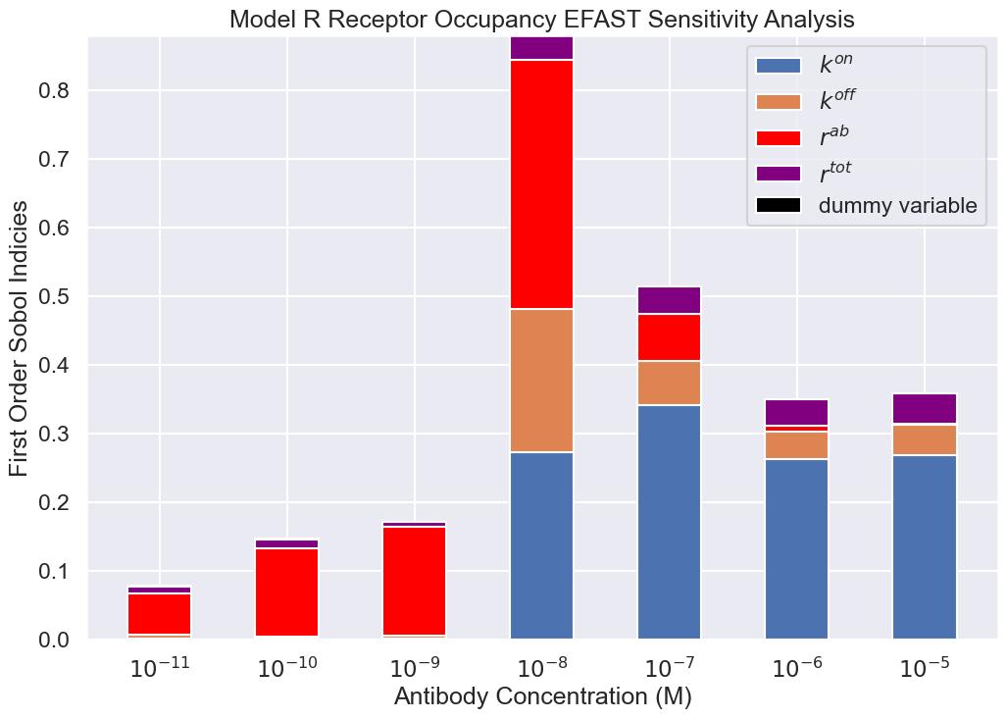

Slide 5
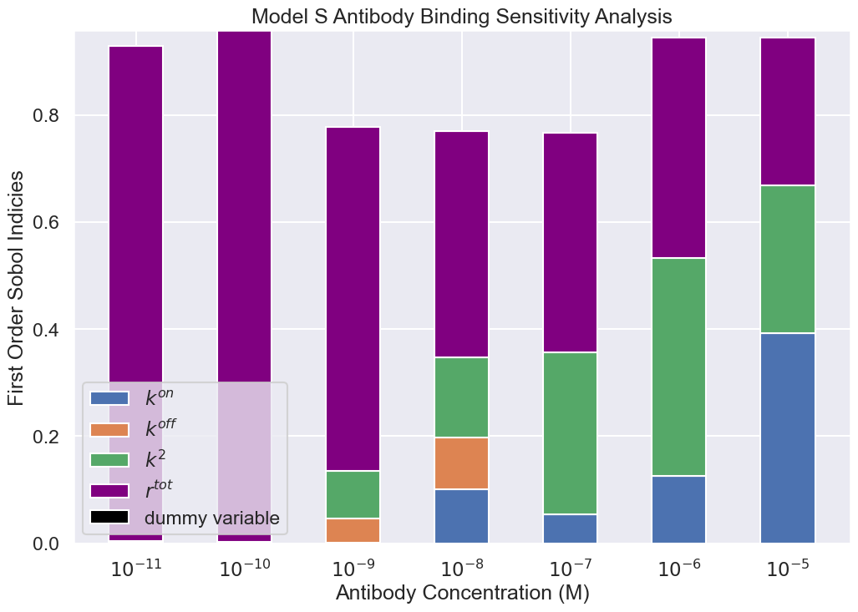
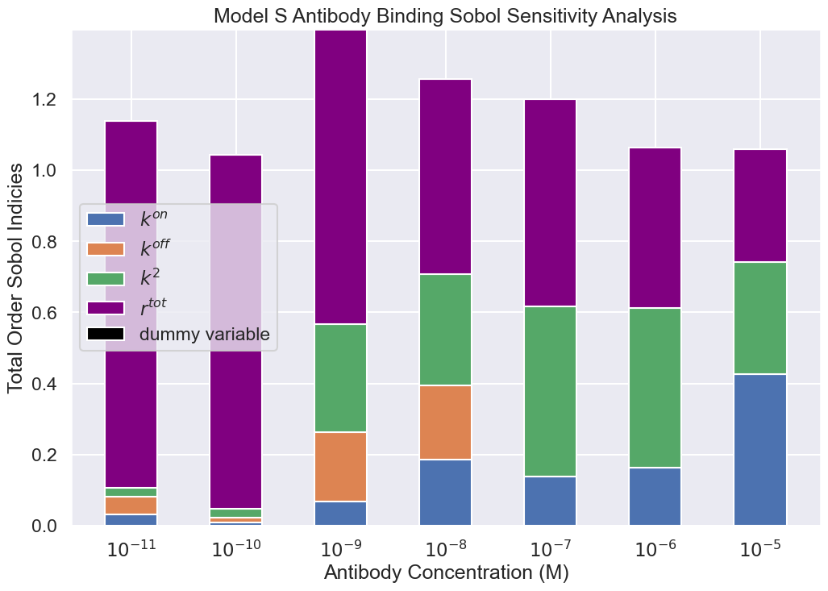
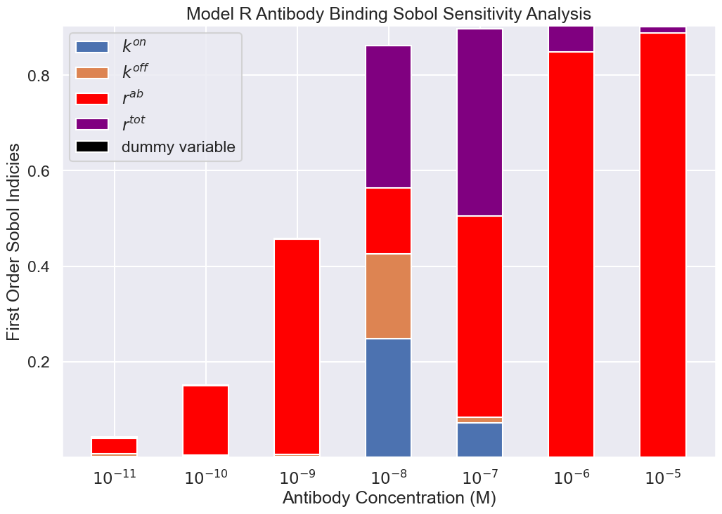
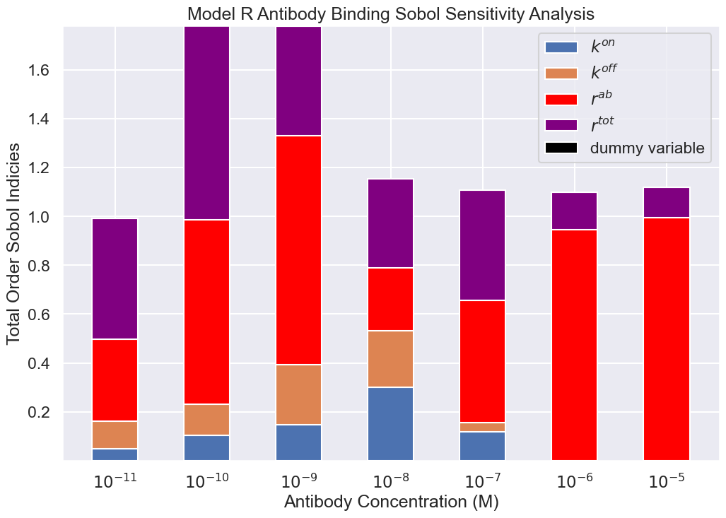
Sobol Analysis for bound antibody

Slide 6
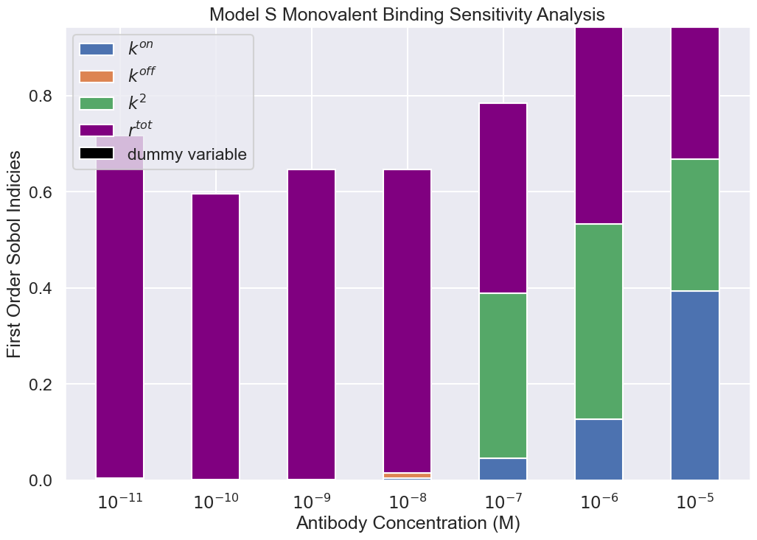
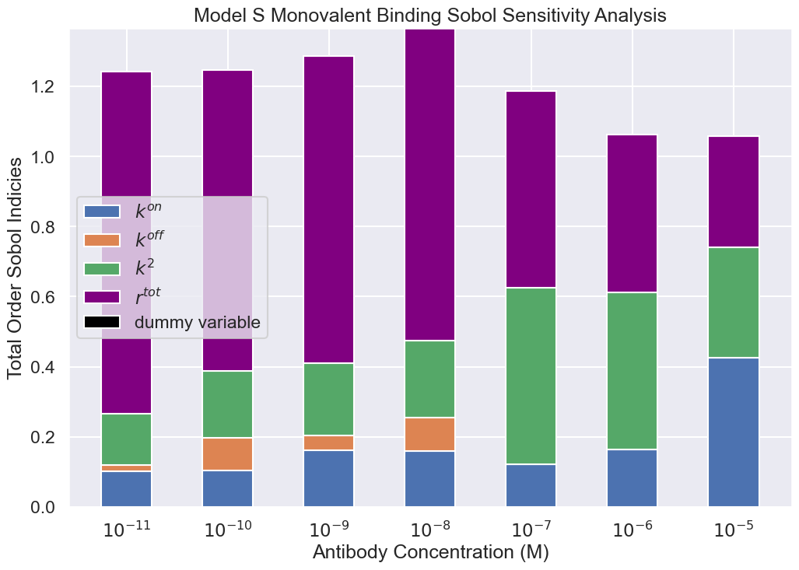
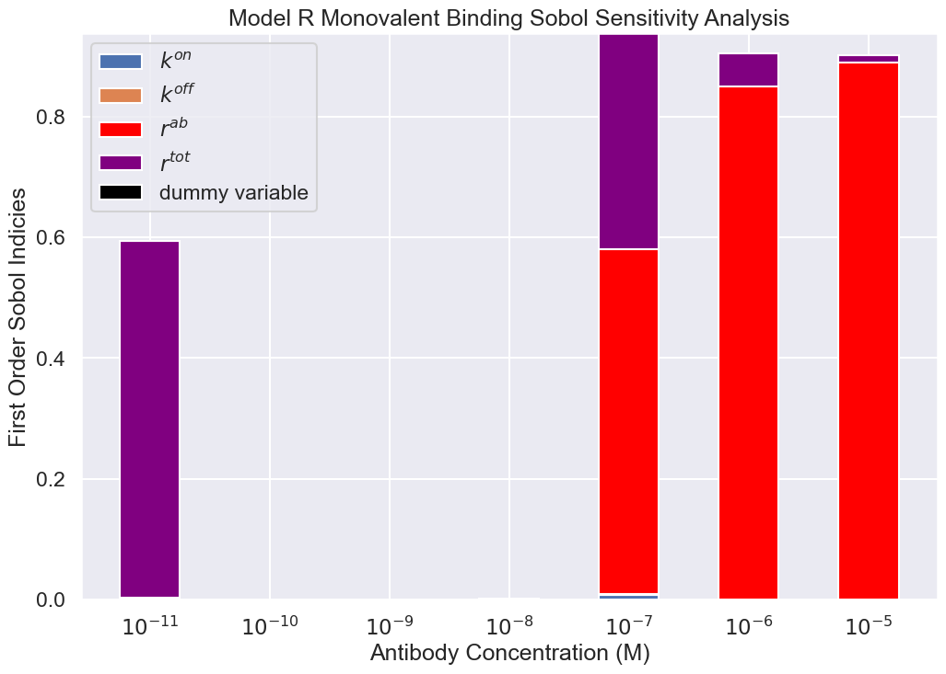
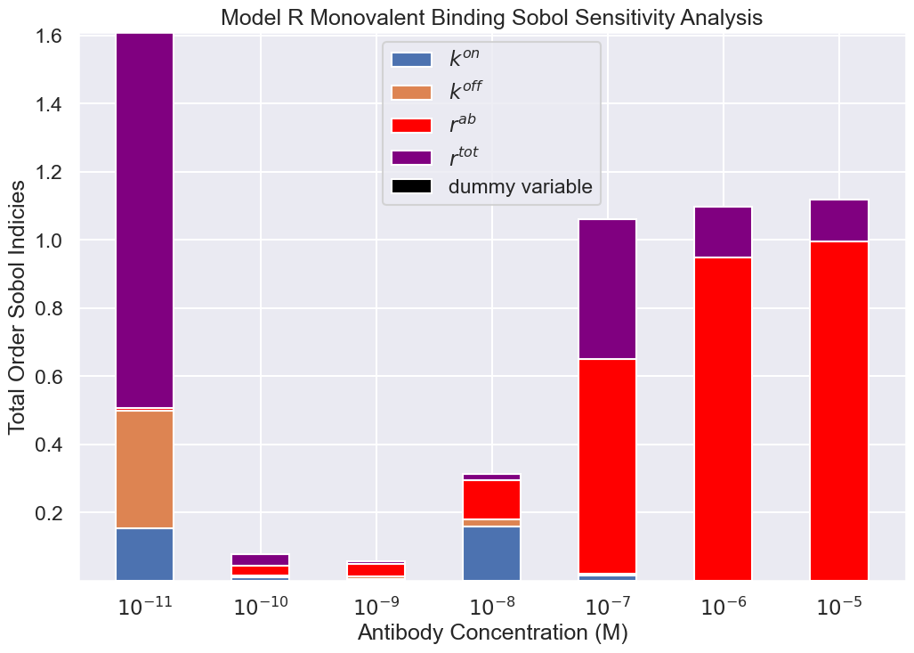
A1 state sensitivity analysis

Slide 7
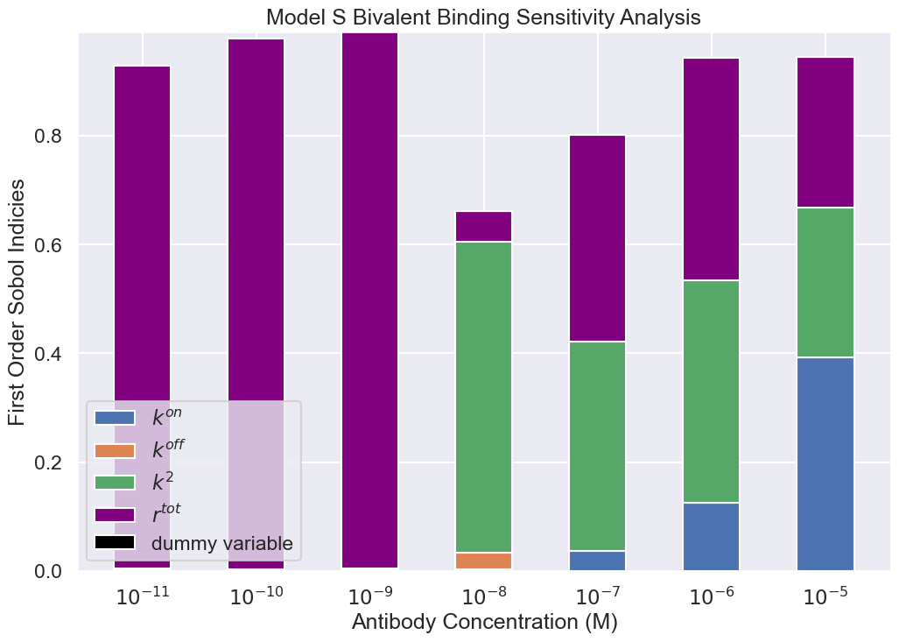
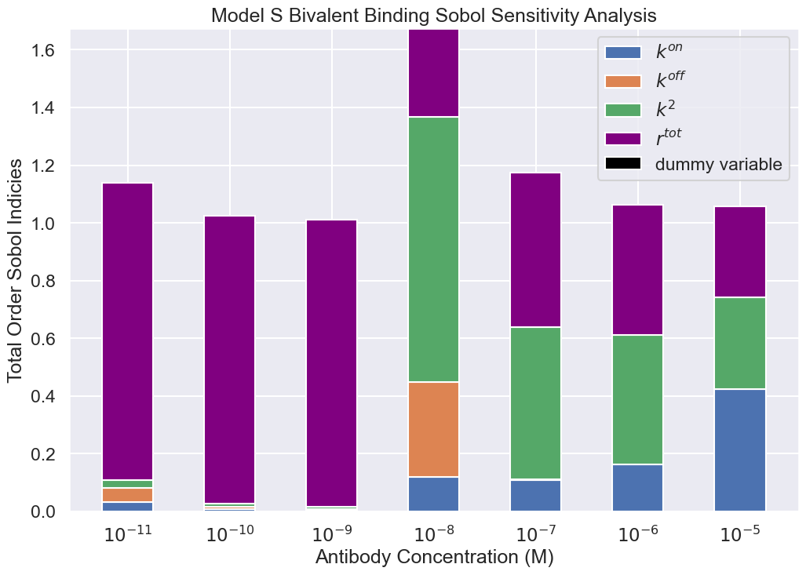
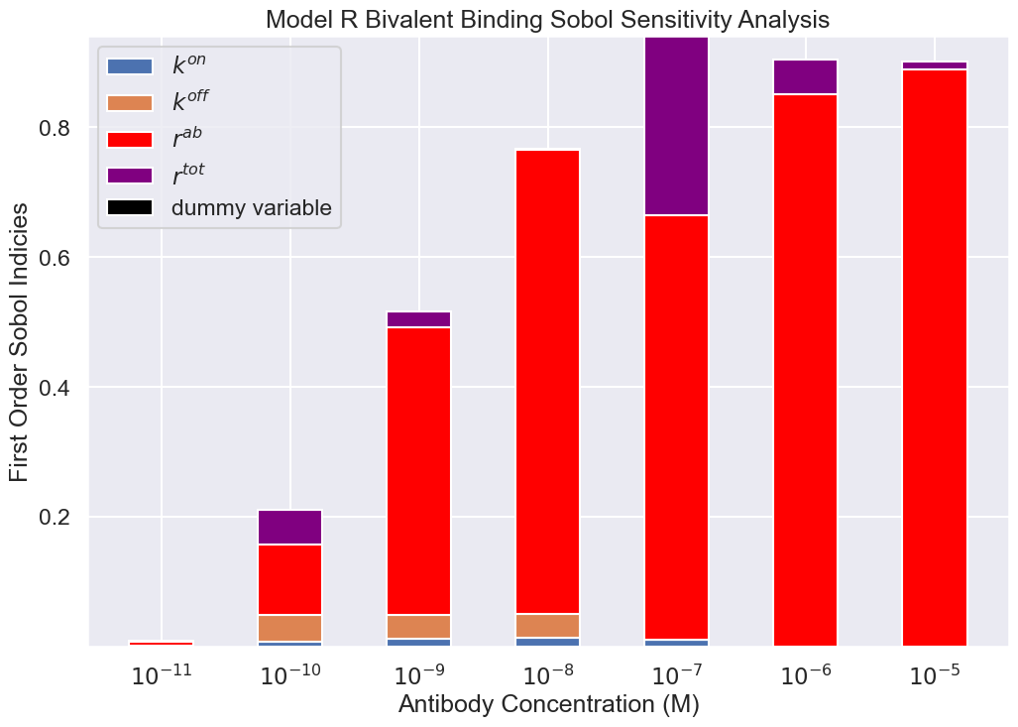
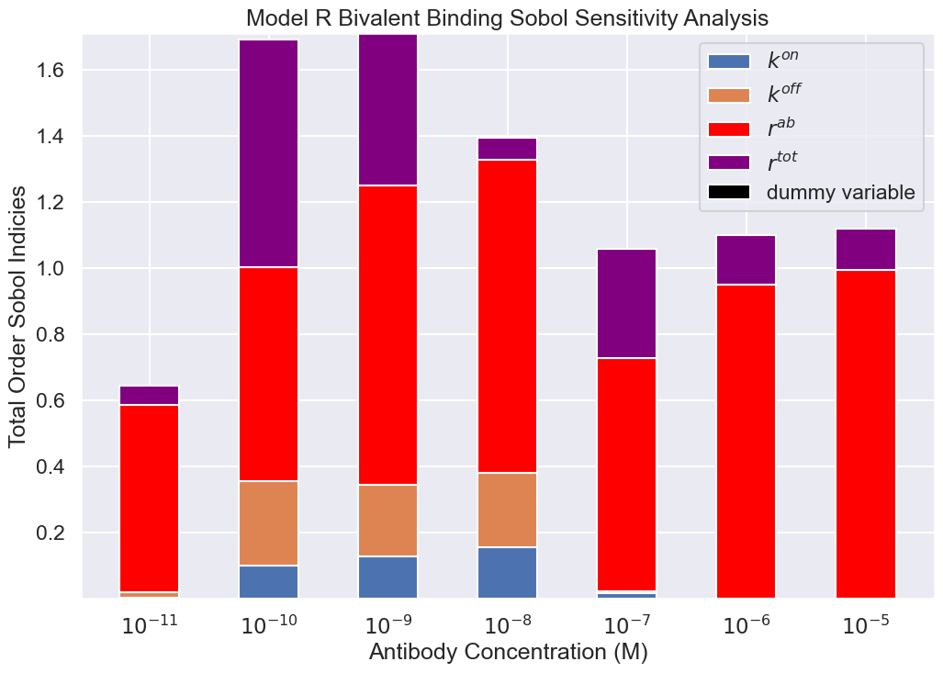
A2 state sensitivity analysis

Slide 8
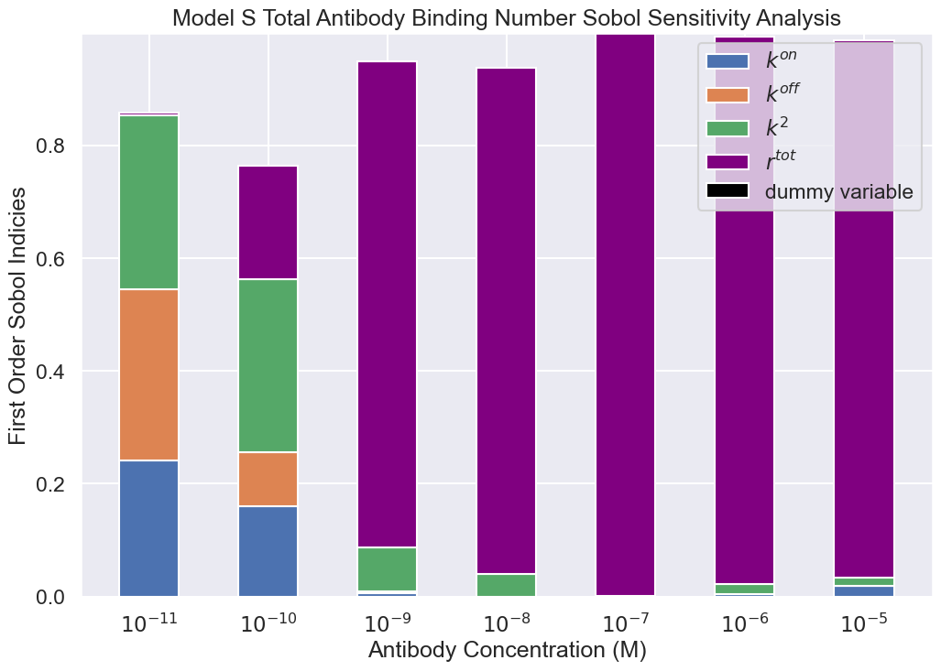
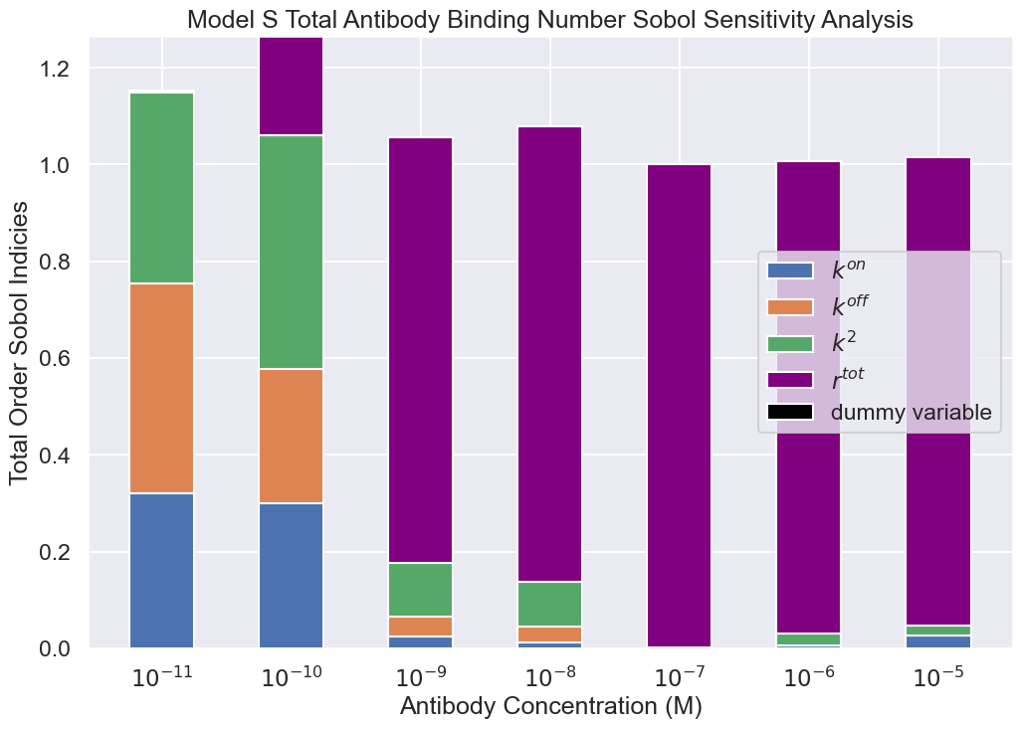
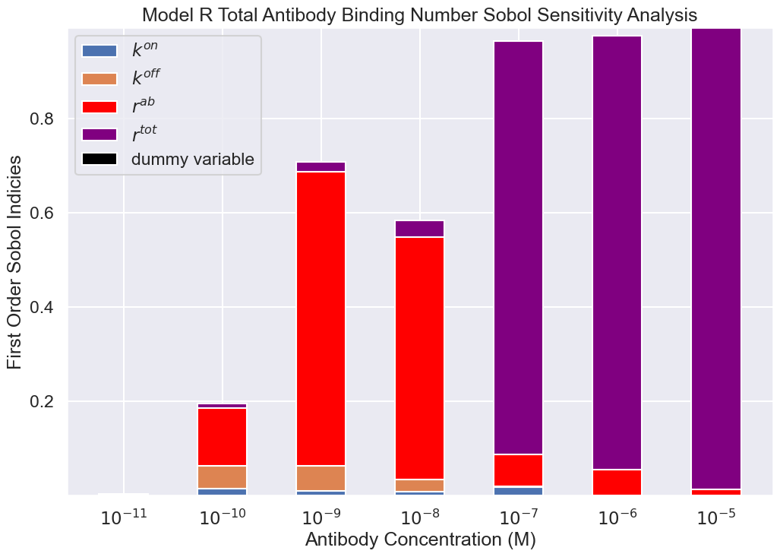
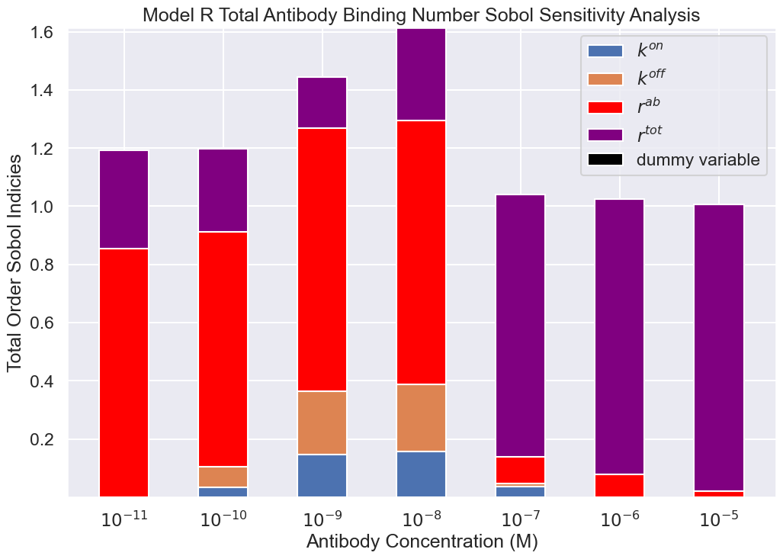
Total Antibody Number Sensitivity Analysis

Slide 9
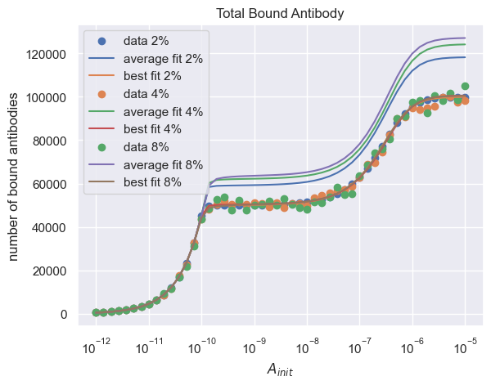
Steady State Parameter Fits
Noise | Rtot avg | Rtot best | K2 avg | K2 best | Koff avg | Koff best
2% | 1.18e5 | 1e5 | 101 | 100 | 5e-4 | 1e-4
4% | 1.24e5 | 1e5 | 116.25 | 115.8 | 8e-4 | 5.5e-4
8% | 1.27e5 | 1e5 | 103.4 | 106.8 | 7.9e-4 | 6e-4

Slide 10
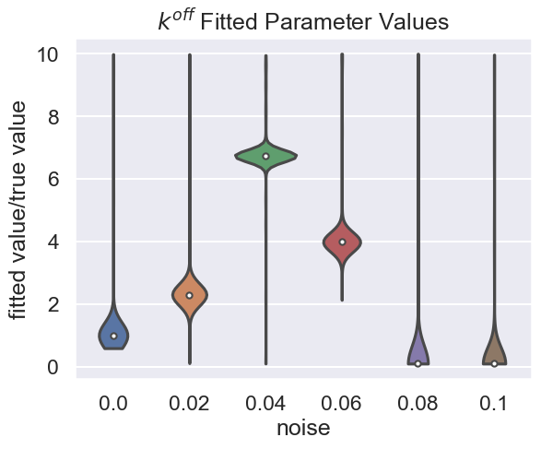
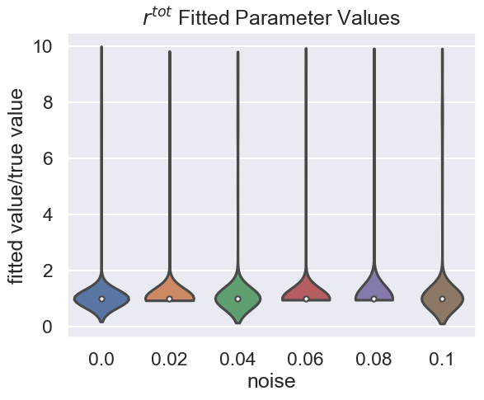
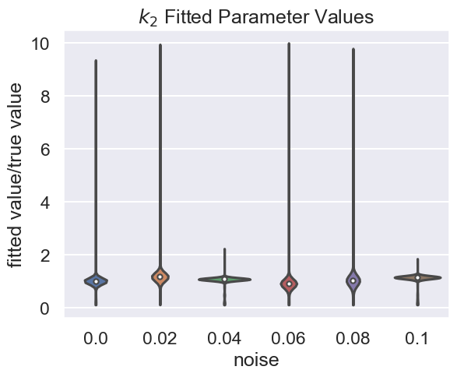

Slide 11
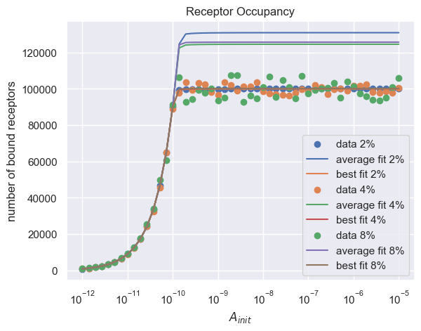
Noise | Rtot avg | Rtot best | K2 avg | K2 best | Koff avg | Koff best
2% | 1.3e5 | 1e5 | 126 | 100.8 | 1.6e-4 | 1e-4
4% | 1.24e5 | 1e5 | 887 | 999 | 2.8e-4 | 2.2e-4
8% | 1.25e5 | 1e5 | 874 | 999 | 1.3e-4 | 1.9e-4

Slide 12
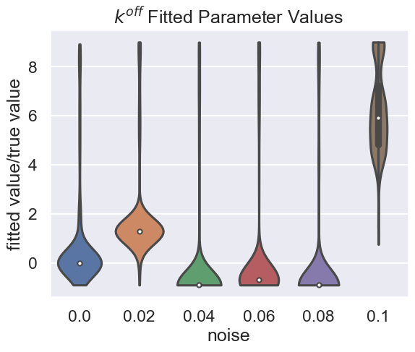
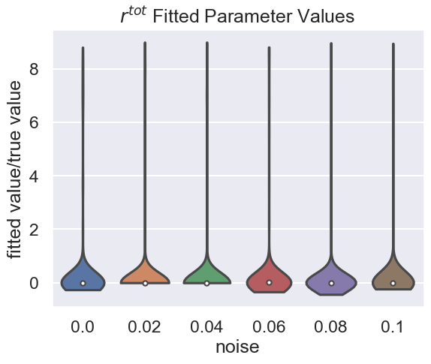
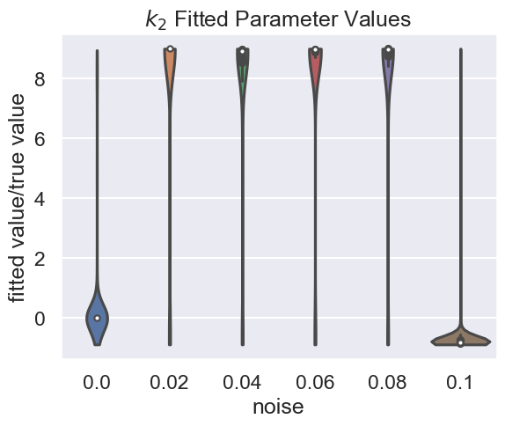

Slide 13
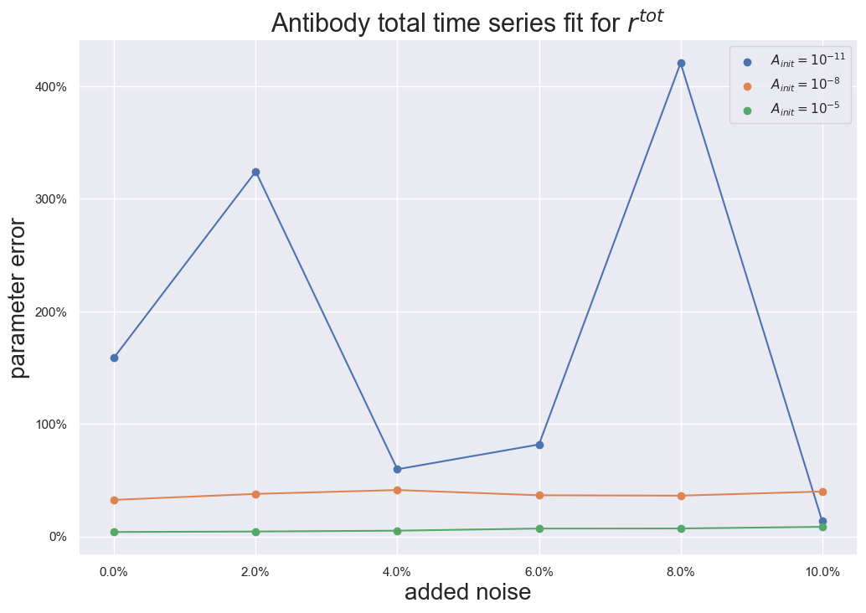
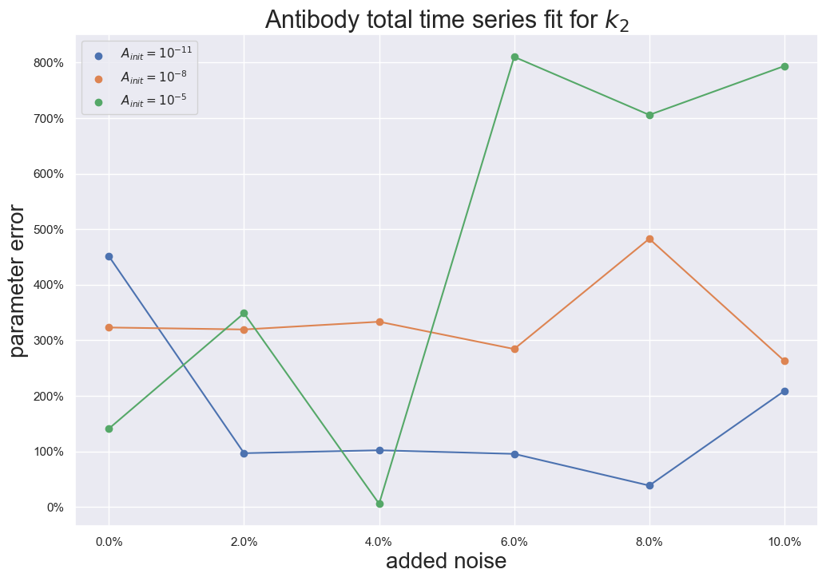
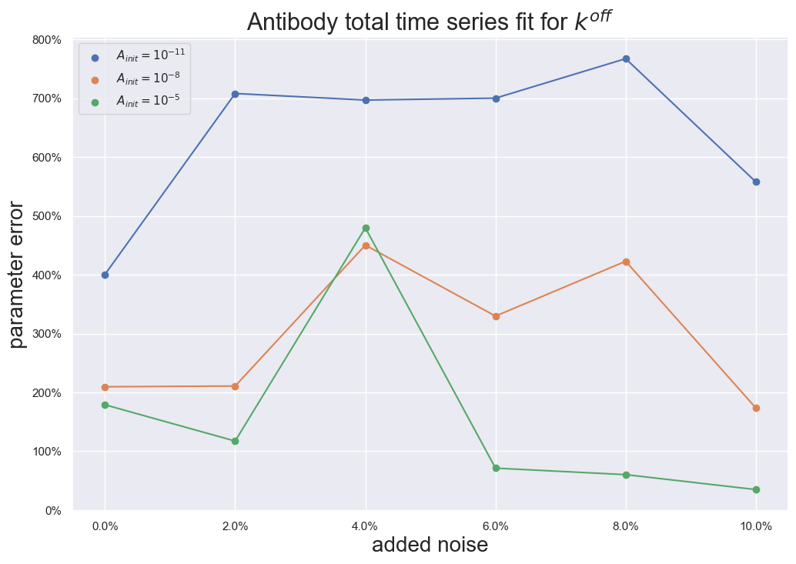
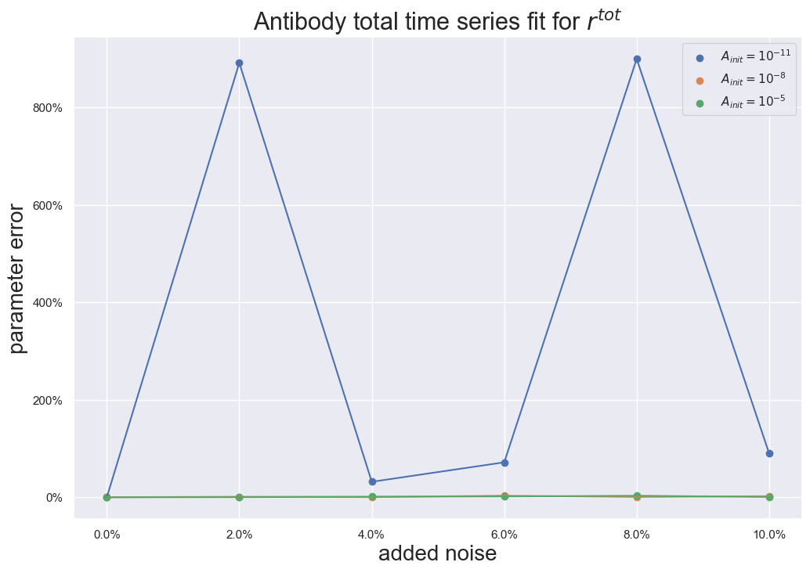
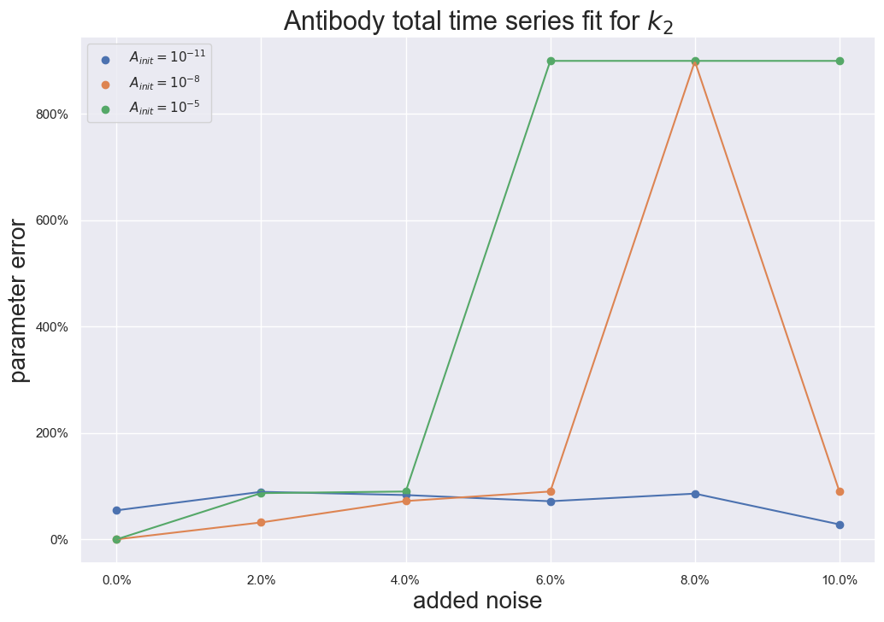
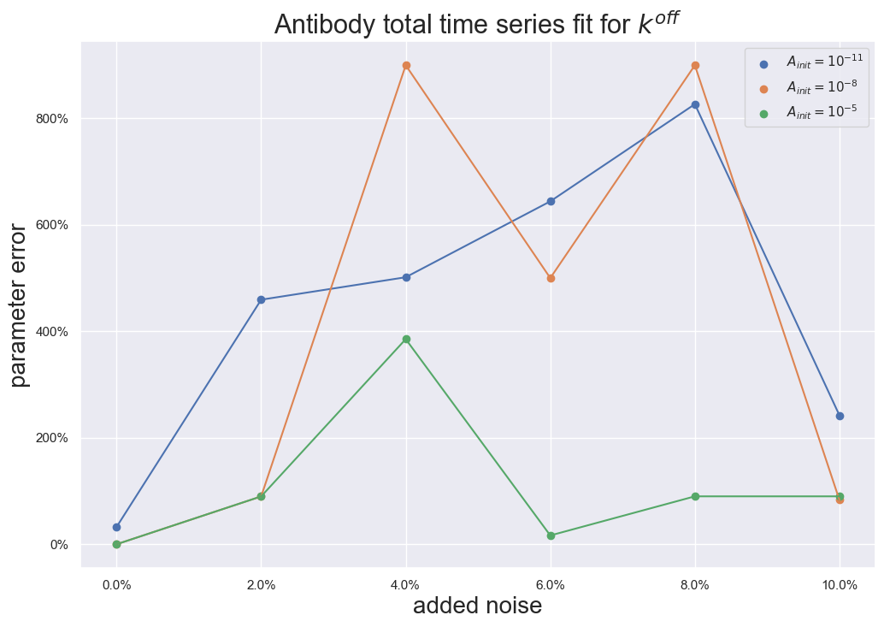
Time series fits
Average
Best

Slide 14
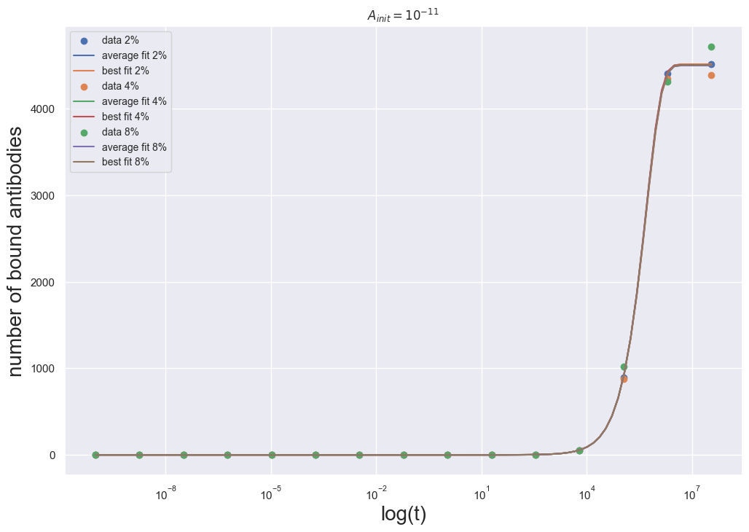
Noise | Rtot avg | Rtot best | K2 avg | K2 best | Koff avg | Koff best
2% | 2.6e5 | 1e5 | 551 | 154 | 5e-4 | 1e-4
4% | 4.2e5 | 9.9e5 | 196 | 182 | 8e-4 | 5.5e-4
8% | 1.5e5 | 1.3e5 | 202 | 183 | 7.9e-4 | 6e-4

Slide 15
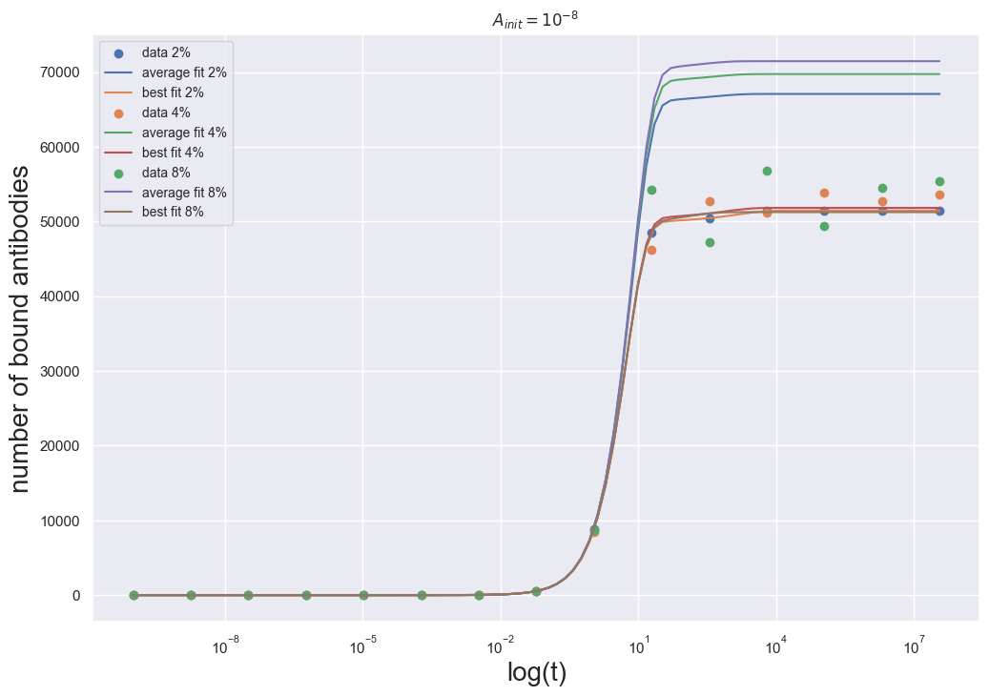
Noise | Rtot avg | Rtot best | K2 avg | K2 best | Koff avg | Koff best
2% | 1.3e5 | 1e5 | 423 | 100 | 3e-24 | 1e-4
4% | 1.3e5 | 1.01e5 | 419 | 131 | 3.3e-4 | 1.8e-4
8% | 1.4e5 | 1e5 | 433 | 172 | 5e-4 | 9e-4

Slide 16
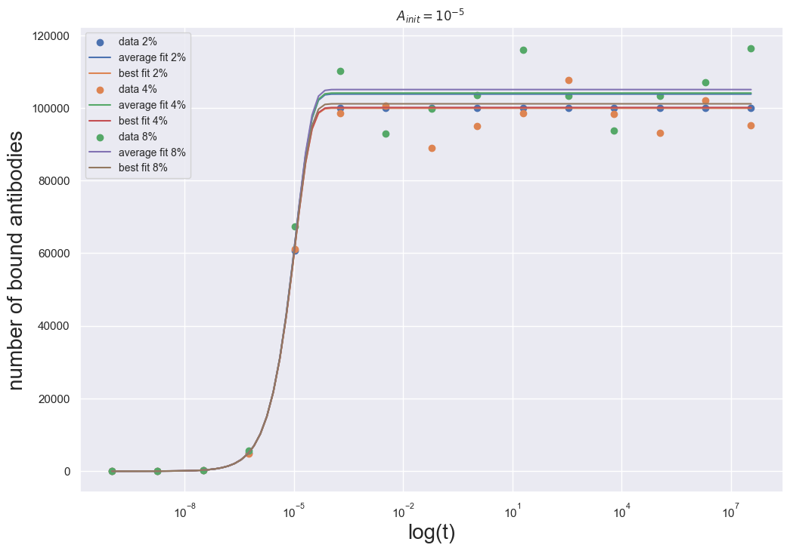
Noise | Rtot avg | Rtot best | K2 avg | K2 best | Koff avg | Koff best
2% | 1.03e5 | 1e5 | 241 | 100 | 2e-4 | 1e-4
4% | 1.04e5 | 1e5 | 448 | 186 | 2.1e-4 | 1.9e-4
8% | 1.05e5 | 1.01e5 | 105 | 189 | 5.8e-4 | 4.8e-4

Slide 17
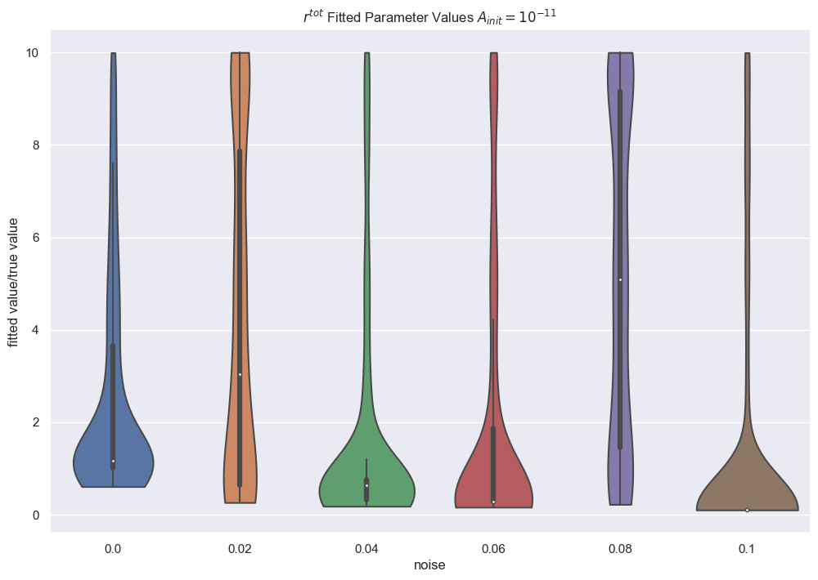
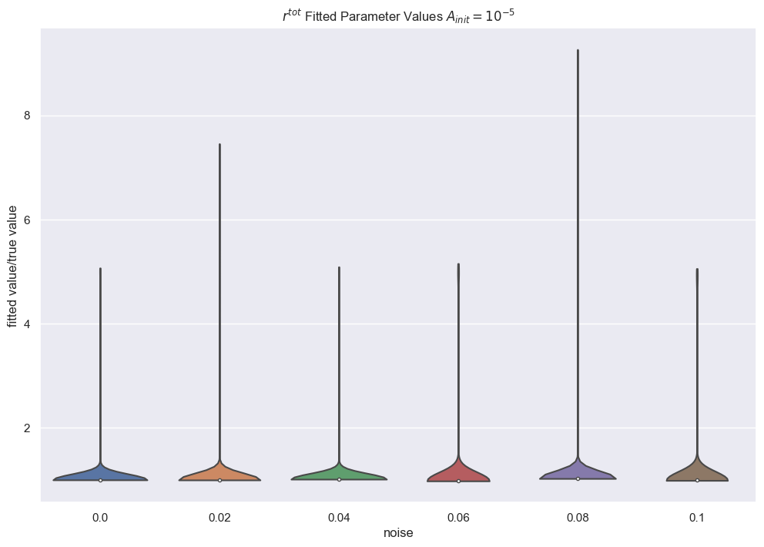
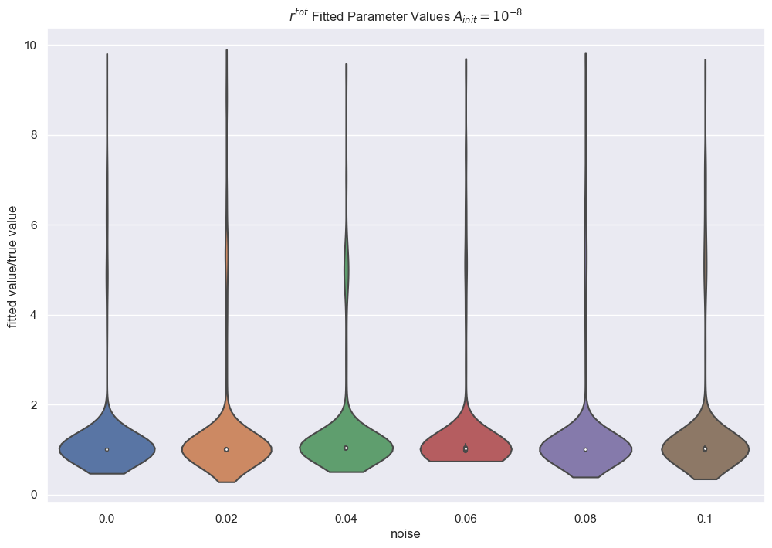

Slide 18
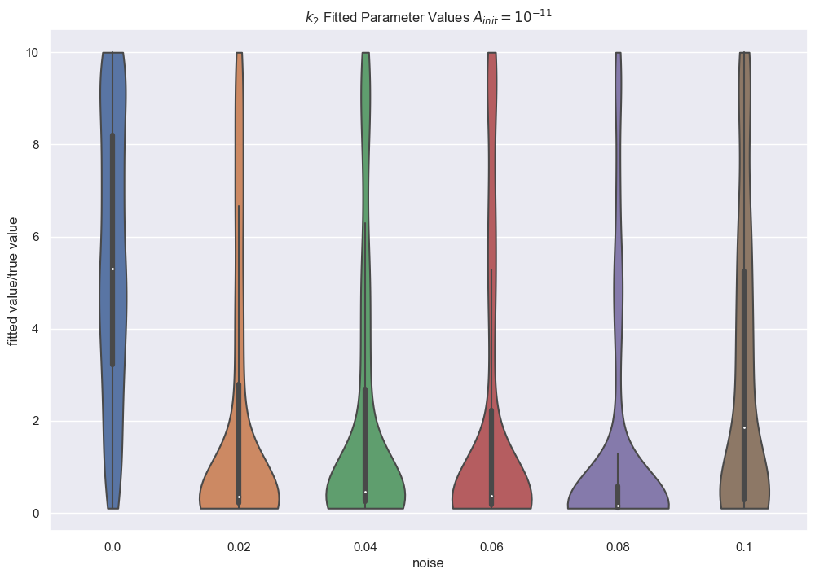
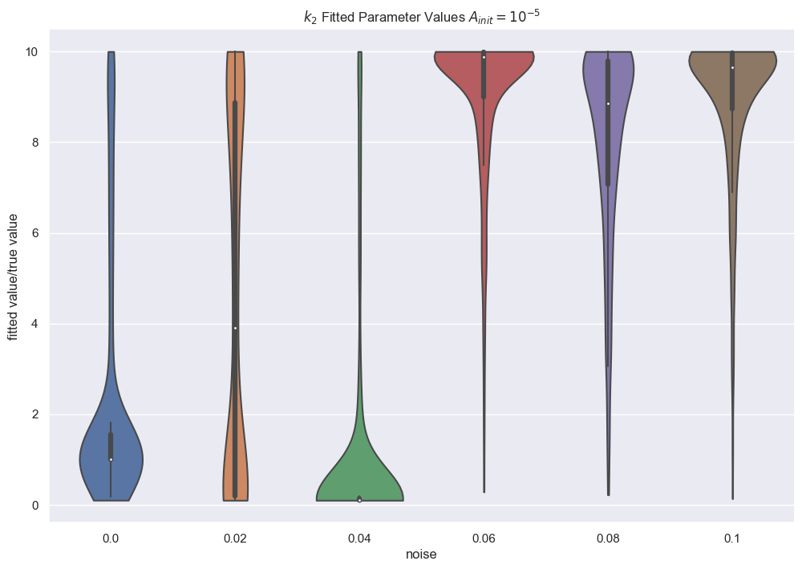
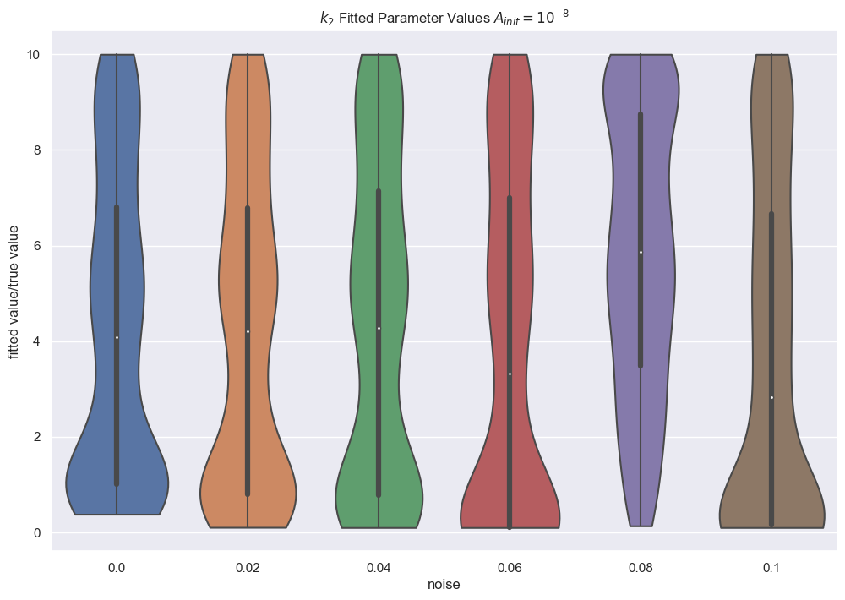

Slide 19
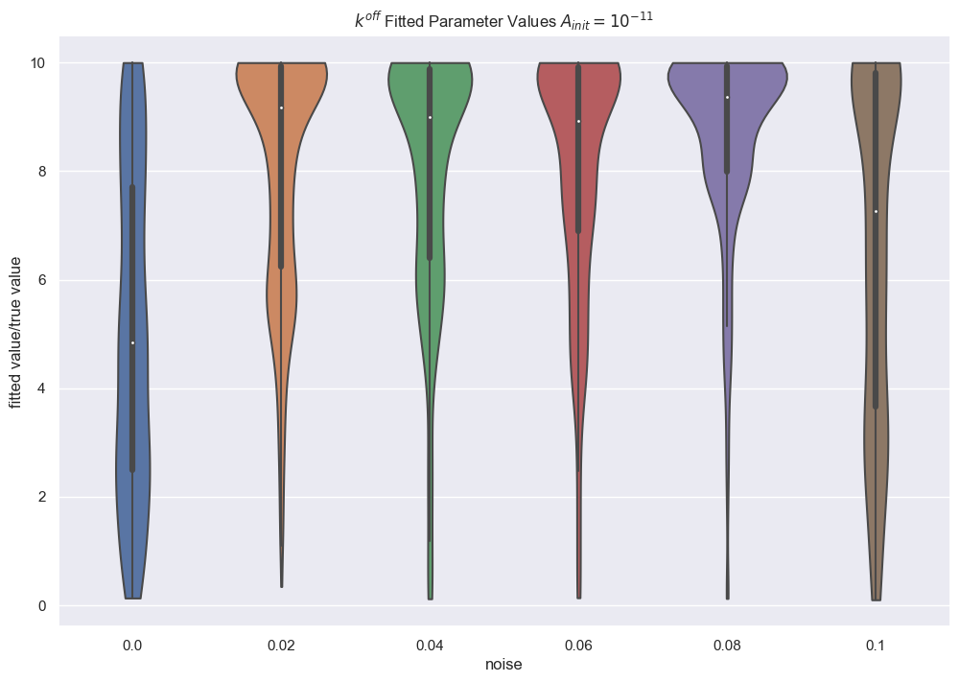
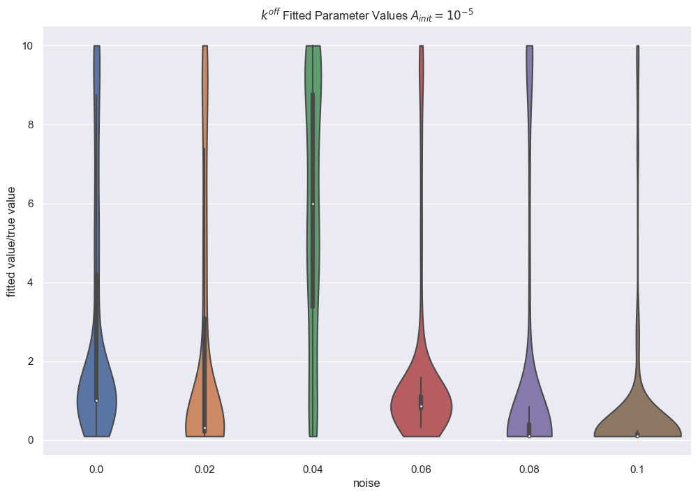
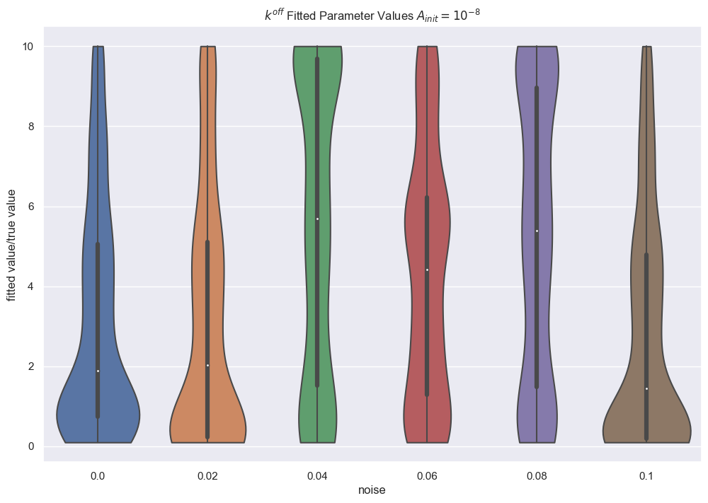

Slide 20
Structural Identifiability
Model S
Model S bispecific
Model R monospecific
Model R bispecific

Slide 21




Model S
Model R

Slide 22




Model S
Model R

Slide 23


Model S
Model R

